Slide 1
Econometrical analysis:
Practical session #1
by Stanislav Sochynskyi
based Natalia Ostapenko slides
26/11/2019

Slide 2

Simple linear regression
Imagine the example where the health officials want to explain the effects of smoking during pregnancy on birth weight. For this we have simple regression model:

Slide 3
Task (a): Simple linear regression
Plot the variables bwght and cigs in a scatter plot. Discuss the relationship (correlation) between these variables.

Slide 4
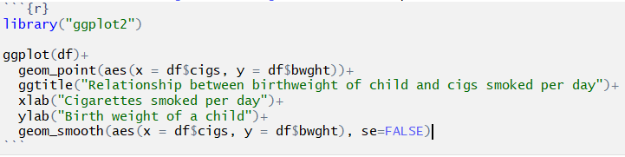
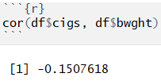
Task (a): Simple linear regression (code)

Slide 5
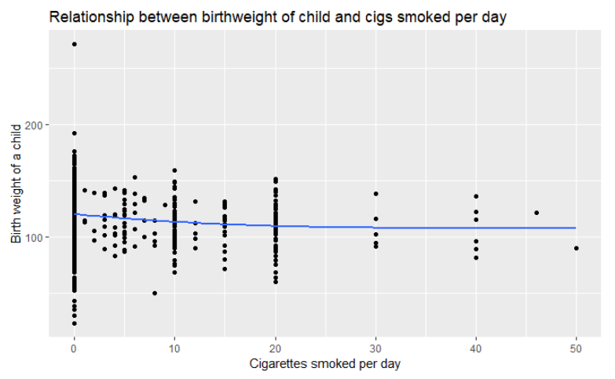
Task (a): Simple linear regression (answer)

Slide 6
Task (b): Simple linear regression
Explain why we expect causality between the two variables bwght and cigs.

Slide 7
Task (b): Simple linear regression (answer)
Explain why we expect causality between the two variables bwght and cigs.
Number of cigarettes smoked might have negative effect on the children [1]
The smoking precedes the child birth
[1] Reproductive Effects https://www.cdc.gov/tobacco/data_statistics/sgr/2004/pdfs/chapter5.pdf

Slide 8
Task (c): Simple linear regression
Discuss if the model satisfies the basic assumptions of the SLR. In particular do we expect correlation between the error and the regressor? What is the consequence of this correlation? How is it called in econometrics?

Slide 9
Task (c): Simple linear regression (answer)
Assumption SLR1 (linear in parameters) is satisfied because we assume the linear relationship between the variables.
Assumption SLR2 (random sampling) is satisfied because the data is a survey which uses randomization in methodology.

Slide 10
Task (c): Simple linear regression (answer)
Assumption SLR3 (zero conditional mean)
Measurement error. Which means that our variable cigs is measured with error. It might happen if people lie about the number of cigarettes smoked. Is it plausible? Yes.
Simultaneity/reverse causality. Which means that birth weight might has effect on the number of cigarettes smoked. Is it plausible? It might, depends on timing of survey.
Omitted variable bias. Means that there is omitted variable which have an effect on birth weight and is correlated with the number of cigarettes smoked

Slide 11
Task (c): Simple linear regression (answer)
Assumption SLR3 (zero conditional mean)
Example #1: Poorer women might smoke more and do not have money for more healthy food.
Example #2: Less healthy women might smoke more and the mother’s health might have effect on childbirth weight.

Slide 12

Task (c): Simple linear regression (answer)
Assumption SLR4 (sample variation in the independent variable) is satisfied as observations/independent variables are not equal.

Slide 13
Task (c): Simple linear regression (answer)
Assumption SLR5 (Homoscedasticity) most probably is not satisfied. In this case, the estimates are still unbiased, but we cannot do statistical tests!

Slide 14
Task (c): Simple linear regression
In particular do we expect correlation between the error and the regressor? What is the consequence of this correlation? How is it called in econometrics?

Slide 15
Task (c): Simple linear regression (answer)
In particular do we expect correlation between the error and the regressor? What is the consequence of this correlation? How is it called in econometrics?
The consequence is that our beta coefficient is biased.
It is called the endogeneity.

Slide 16
Task (d): Simple linear regression
Run the simple regression and obtain the estimation output. Comment on what the intercept and slope mean.

Slide 17
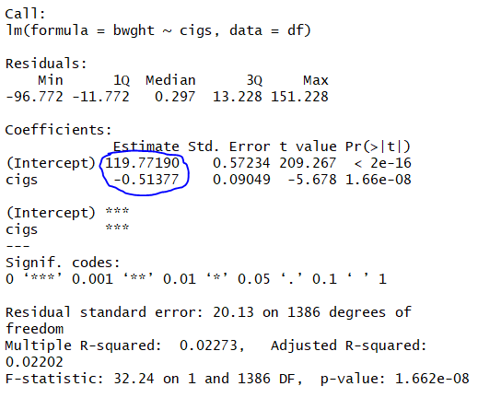


Task (d): Simple linear regression (answer)
$$←$$

Slide 18
Task (d): Simple linear regression (answer)
Intercept: for those who smoke 0 cigarettes per day the average birth weight of a child is 119.77. Average birth weight for non-smoking women is 119.
Slope: each additional cigarette smoked is associated with 0.51 lower birth weight.

Slide 19
Task (e): Simple linear regression
Go over the R estimation output: explain what each number means and explain if and how they are related.

Slide 20





Task (e): Simple linear regression (answer)
what percent of variation of the dependent variable we explain with the regression.
Residual standard error: square root of the mean square error.

Slide 21

Task (f): Simple linear regression
Explain the partial effect of cigs on bwght in this model.

Slide 22
Task (f): Simple linear regression (answer)
Explain the partial effect of cigs on bwght in this model.
Each additional cigarette smoked is associated with 0.51 lower birth weight.

Slide 23
Task (g): Simple linear regression
Comment on the significance of the coefficients and their significance.

Slide 24

Task (g): Simple linear regression (answer)
Comment on the significance of the coefficients and their significance.
t-stat (this slide), p-value (slide 24) and confidence interval (slide 25) tell us about that!
Means the result is statistically significant at 0.05 level
$$t_{stat}≥1.96$$

Slide 25









Task (g): Simple linear regression (answer)
How it looks like
in R output
$$←$$
If less than 0.1 - statistically significant at 0.1 level;
If less than 0.05 - statistically significant at 0.05 level;
If less than 0.01 - statistically significant at 0.01 level;
If less than 0.001 - statistically significant at 0.001 level;
Here it is statistically significant at less 0.01 level - great!
$$←$$
$$←$$
$$←$$
$$←$$

Slide 26
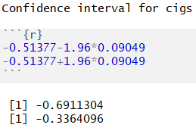
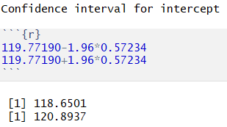

Task (g): Simple linear regression (answer)
$Confidence interval=coef\left(+ AND −\right) 1.96∗S.E.$ - does not include 0 - excellent!

Slide 27
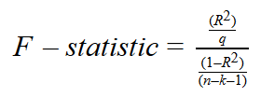


Task (g): Simple linear regression (answer)
Joint significance
F should be compared to tables
In case of Simple LR t-test and F test do same
$$F\left(32.24\right) equal to t^{2} ({−5.678}^{2})$$

Slide 28
Task (h): Simple linear regression
Calculate the two sided confidence interval for the coefficients with 95% confidence level.
Calculate the confidence interval for one sided confidence interval: H1 : β₁ < 0 - in theory, cigs can not positively affect bwght

Slide 29
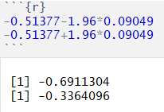
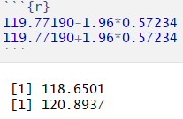
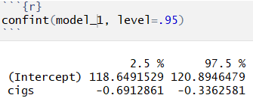
Task (h): Simple linear regression (answer)
For cigs
For intercept
Code

Slide 30
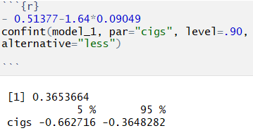
Task (h): Simple linear regression (answer)
One-sided confidence interval is: (−∞; −0.6621736).
0 is not contained in the interval, therefore we can reject H0 in favor of alternative hypothesis that H1 : β₁ < 0.

Slide 31

Task (i): Simple linear regression
Comment on the $R^{2}$ of the model.

Slide 32
Task (i): Simple linear regression (answer)
The model explains 2.273% of variation of the dependent variable. Proportion of variance in the target attribute that is predictable from the source attribute.
Basically, measures how well the data follow the regression line

Slide 33
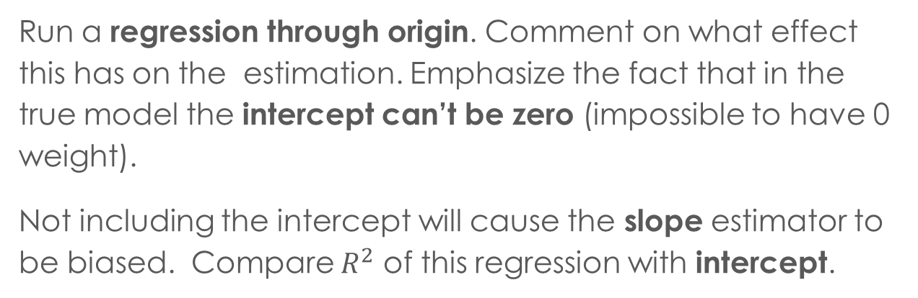
Task (j): Simple linear regression
Run a regression through origin. Comment on what effect this has on the estimation. Emphasize the fact that in the true model the intercept can’t be zero (impossible to have 0 weight).
Not including the intercept will cause the slope estimator to be biased. Compare $R^{2}$ of this regression with intercept.

Slide 34
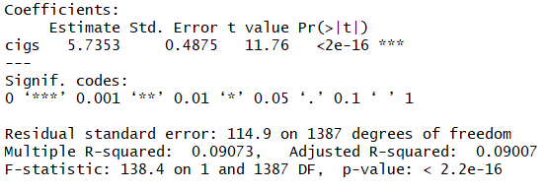
Task (j): Simple linear regression (code)
regression through origin (without intercept)
with intercept

Slide 35
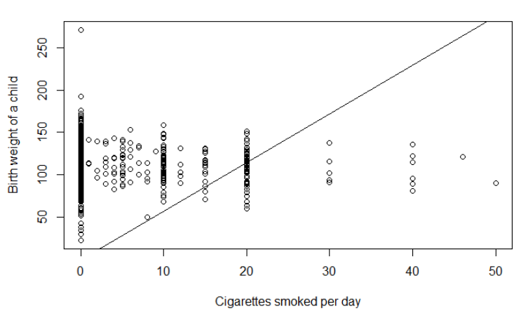

Task (j): Simple linear regression (code)

Slide 36
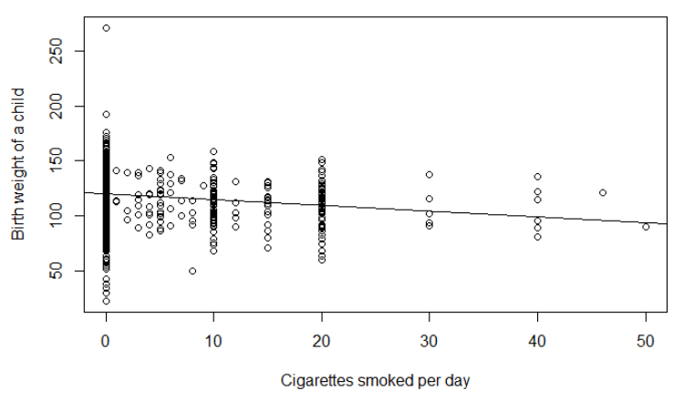

Task (j): Simple linear regression (code)

Slide 37
Task (k): Simple linear regression
Run a regression using packs as a regressor instead of cigs: Compare the estimation results with part (d). Could we include both packs and cigs as regressors?

Slide 38
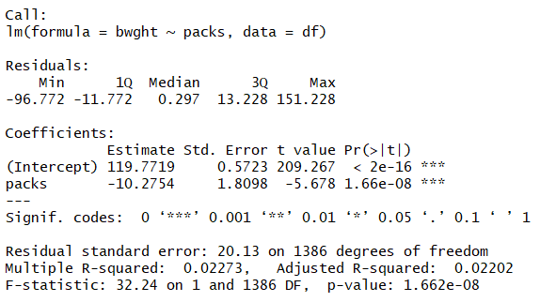
Task (k): Simple linear regression (answer)
The negative association between birth weight of a child and packs is much higher than with cigs. (20*--0.51)

Slide 39
Task (l): Simple linear regression
Could we include both packs and cigs as regressors?

Slide 40
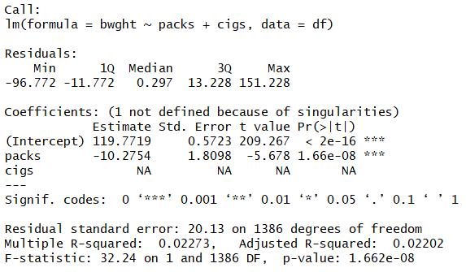
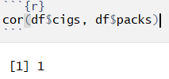
Task (l): Simple linear regression (answer)
No, they are perfectly correlated!

Slide 41
Multiple linear regression
Now imagine that we include another factor called family income (faminc) that affects the birth weight. We run the following regression:

Slide 42
Task (a): Multiple linear regression
Why do you think faminc could be related to bwght?

Slide 43
Task (a): Multiple linear regression (answer)
Why do you think faminc could be related to bwght?
Richer women might be different from the poor
Richer women might acquire better access to medical care
Richer women might have better health conditions

Slide 44
Task (b): Multiple linear regression
Estimate the model. Explain if R-squared is improved and comment on it. How did adjusted R-squared change?

Slide 45
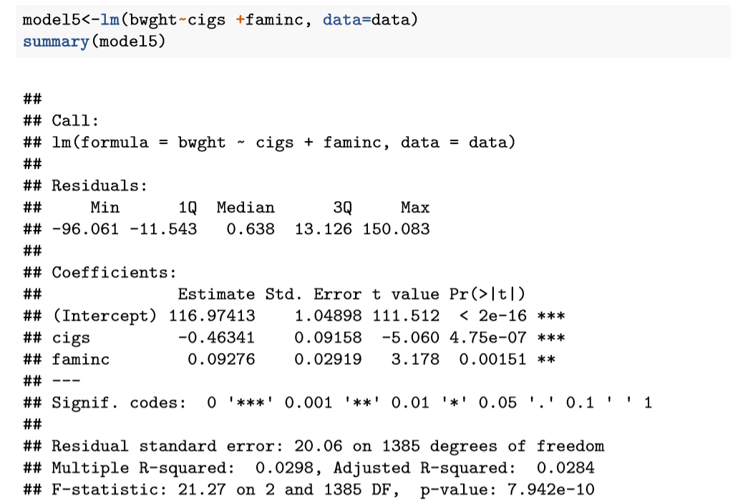
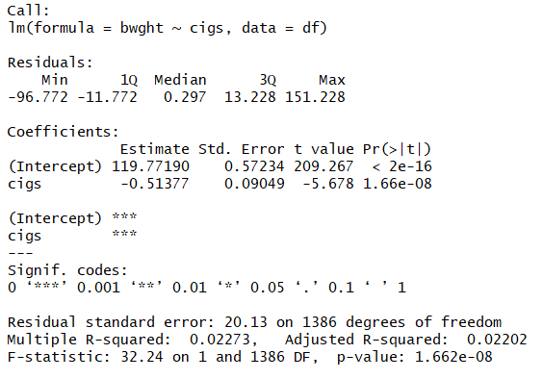
Task (b): Multiple linear regression (answer)

Slide 46
Task (c): Multiple linear regression
Comment on the significance of the coefficients and joint significance.

Slide 47
Task (c): Multiple linear regression (answer)
Comment on the significance of the coefficients and joint significance.
All coefficients are jointly significant at 1% level
Individual coefficients are significant at 1% level

Slide 48
Task (d): Multiple linear regression
Comment on if the two regressors can be correlated. Check the correlation between the regressors and comment on possible multicollinearity. How would the multicollinearity affect the estimators? Calculate the variance inflation factor (VIF) for the coefficients and comment.

Slide 49
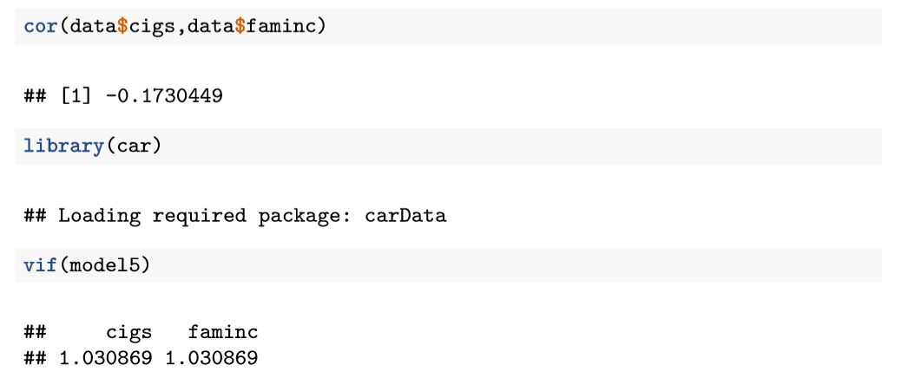
Task (d): Multiple linear regression (code)
VIF BELOW 10 – good!

Slide 50
Task (d): Multiple linear regression (answer)
If we suppose that richer (poorer) women suppose to smoke more (less)
Perfect multicollinearity will give us problems with identification of betas
Not perfect multicollinearity does not actually bias results; it just produces large standard errors in the related independent variables

Slide 51
Task (e): Multiple linear regression (answer)
Could there be still omitted variable bias? Explain.

Slide 52
Task (e): Multiple linear regression (answer)
Now the omitted variables should have an effect on the birth weight and be correlated with cigs or faminc:
Maybe smarter women are more healthy and have higher family income
Married women might smoke less and be more healthy
Women who are living in bad areas might have lower income and be less healthy

Slide 53
Task (f): Multiple linear regression (answer)
Include another variable which is an interaction term: cigs ∗ faminc. Estimate the model. Derive the equation for partial effect of cigs. Calculate and perform a test of significance on the partial effect of cigs for an average family income level. (using margins command in R). Is the sign of β₃ as expected?

Slide 54
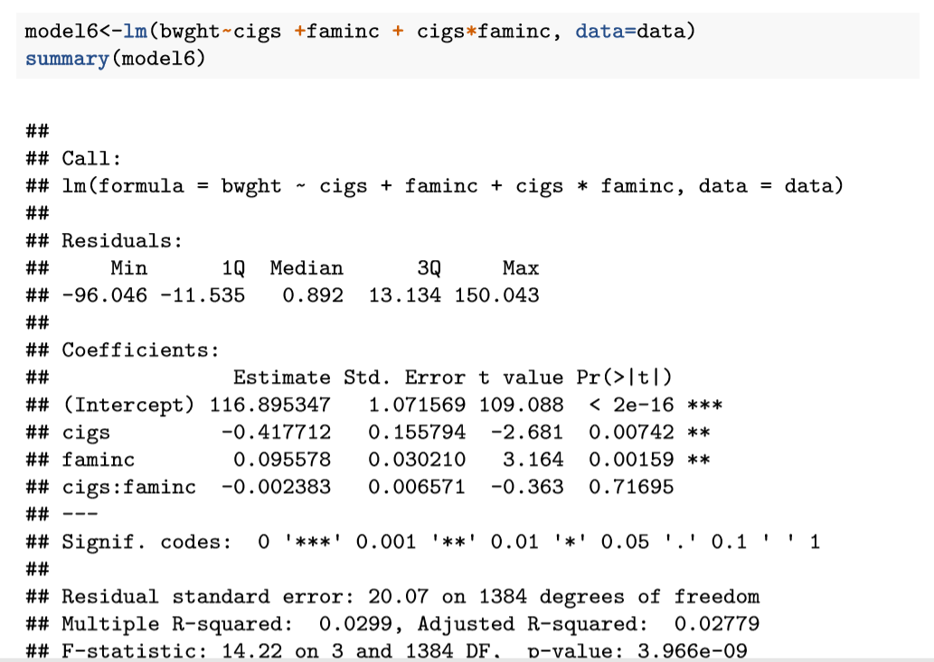
Task (f): Multiple linear regression (answer)

Slide 55


Task (f): Multiple linear regression (answer)
It is the average change in birth weight when cigs (faminc) increases by one unit.

Slide 56
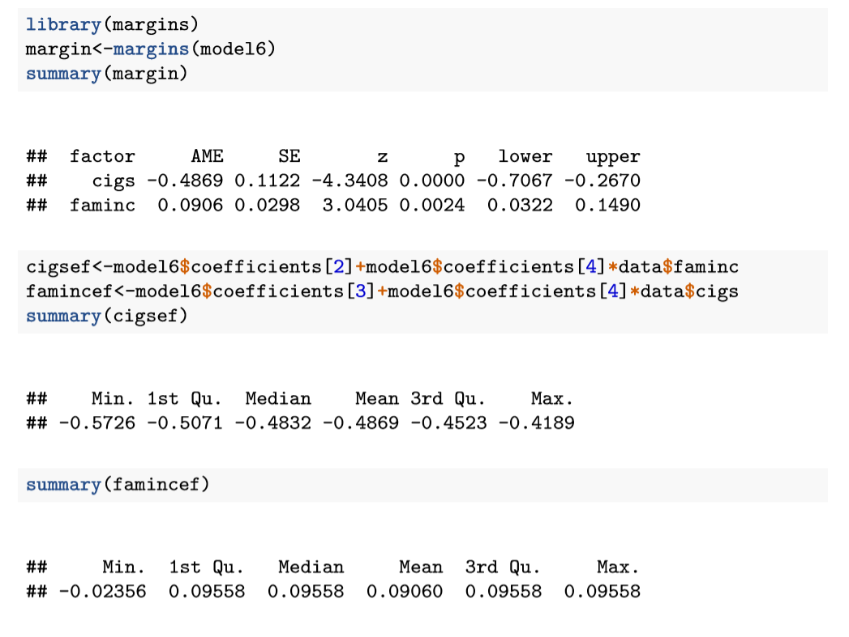
Task (f): Multiple linear regression (answer)

Slide 57
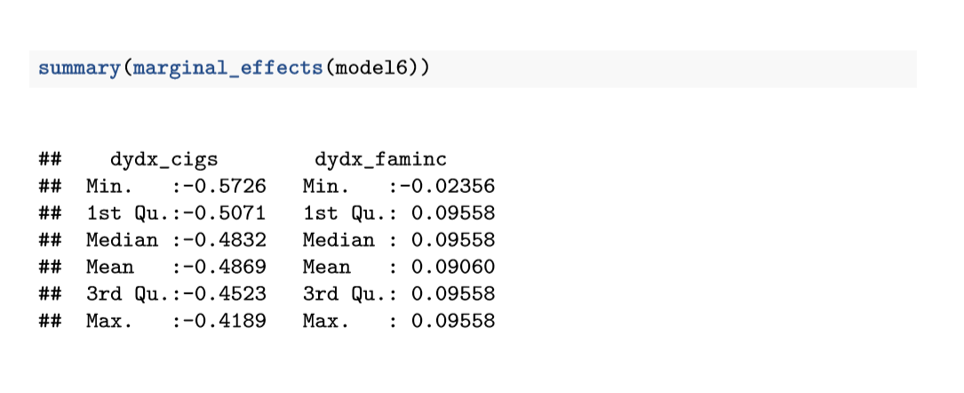
Task (f): Multiple linear regression (answer)

Slide 58
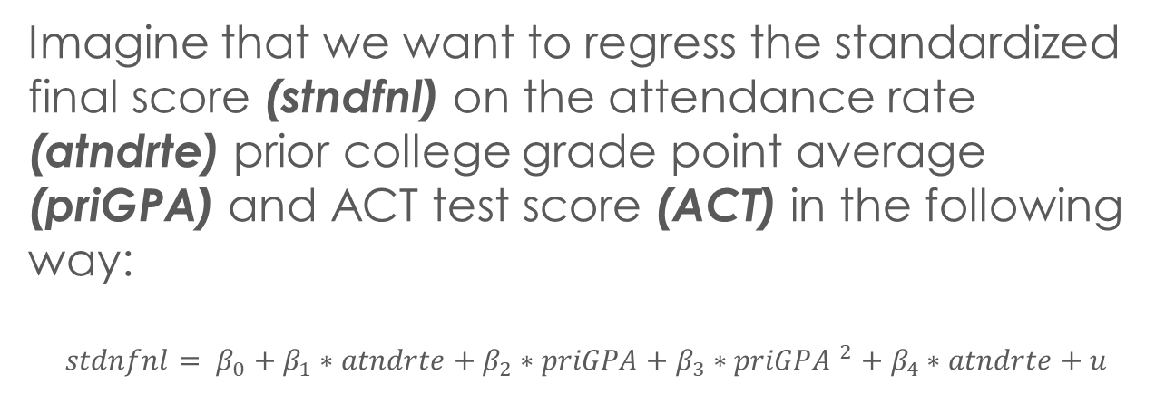
Multiple linear regression # 2
Imagine that we want to regress the standardized final score (stndfnl) on the attendance rate (atndrte) prior college grade point average (priGPA) and ACT test score (ACT) in the following way:
$$stdnfnl= β_{0}+β_{1}∗atndrte+β_{2}∗priGPA+β_{3}∗{priGPA }^{2}+β_{4}∗atndrte+u$$

Slide 59
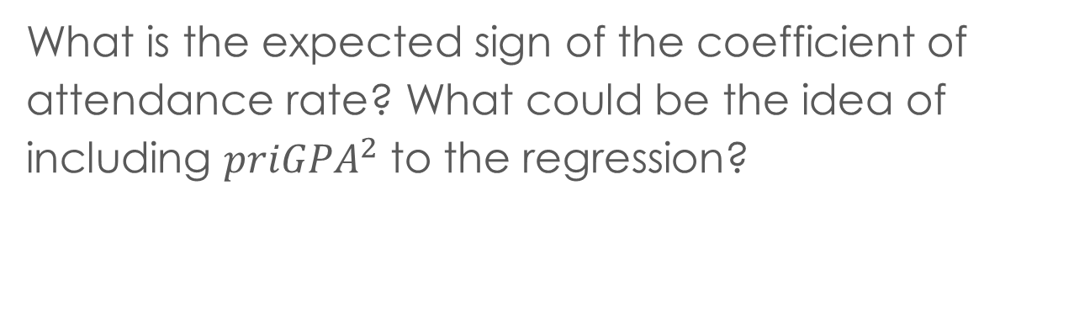
Task (a). Multiple linear regression # 2
What is the expected sign of the coefficient of attendance rate? What could be the idea of including ${priGPA}^{2}$ to the regression?

Slide 60
Task (a). Multiple linear regression # 2 (answer)
The expected sign of the coefficient of attendance rate is positive: the higher the attendance rate - the better the final score should be
We expect that prior college grade point average has non-linear connection with standardized final score

Slide 61
Task (b). Multiple linear regression # 2
Estimate the model. Comment on the coefficients and their significance.

Slide 62
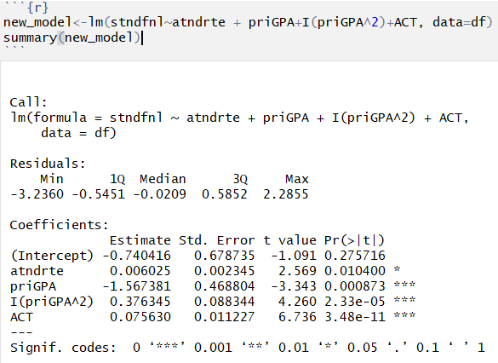
Task (b). Multiple linear regression # 2 (answer)

Slide 63
Task (b). Multiple linear regression # 2 (answer)
Intercept is -0.740416 and it is not statistically significant.
Coefficient of attendance rate is 0.006025 and it is statistically significant at 0.05 level.
Coefficient of prior college grade point average is -1.567381 and it is statistically significant at 0.001 level.
Coefficient of prior college grade point average squared is 0.376345 and it is statistically significant at 0.001 level.
Coefficient of ACT score is 0.07563 and it is statistically significant at 0.001 level.

Slide 64
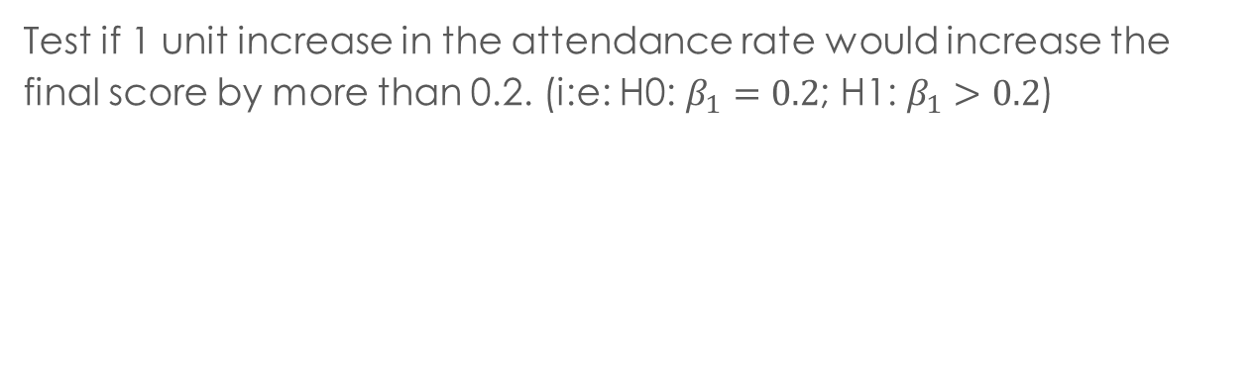
Task (c). Multiple linear regression # 2 (answer)
Test if 1 unit increase in the attendance rate would increase the final score by more than 0.2. (i:e: H0: $β_{1}=0.2$; H1: $β_{1}>0.2$)

Slide 65
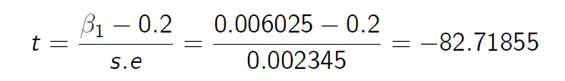
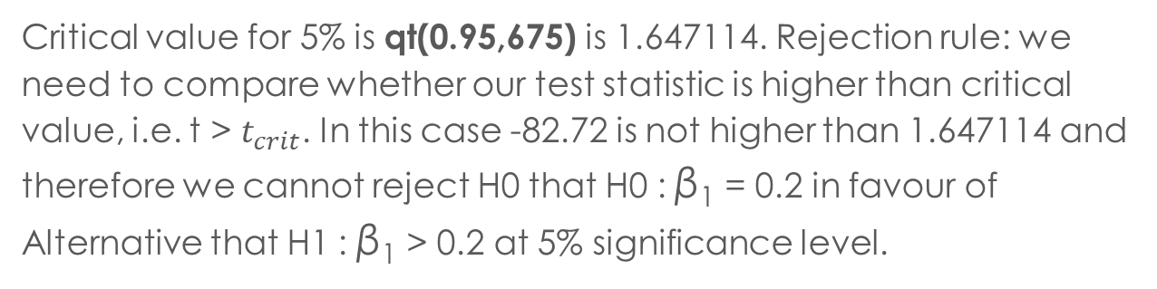
Task (c). Multiple linear regression # 2 (answer)
Critical value for 5% is qt(0.95,675) is 1.647114. Rejection rule: we need to compare whether our test statistic is higher than critical value, i.e. t > $t_{crit}$. In this case -82.72 is not higher than 1.647114 and therefore we cannot reject H0 that H0 : β₁ = 0.2 in favour of Alternative that H1 : β₁ > 0.2 at 5% significance level.

Slide 66
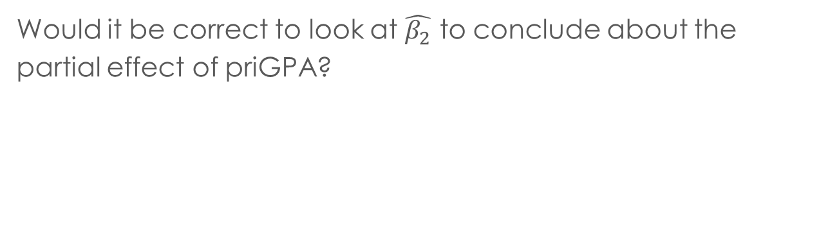
Task (d). Multiple linear regression # 2
Would it be correct to look at $\hat{β_{2}}$ to conclude about the partial effect of priGPA?

Slide 67
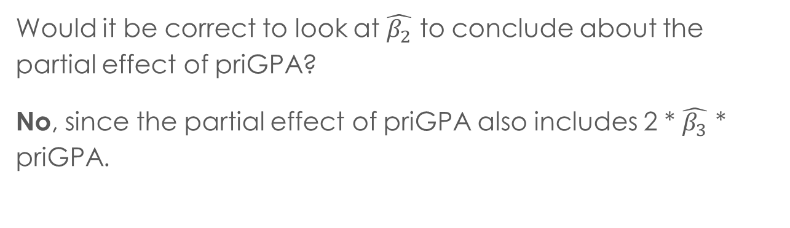
Task (d). Multiple linear regression # 2 (answer)
Would it be correct to look at $\hat{β_{2}}$ to conclude about the partial effect of priGPA?
No, since the partial effect of priGPA also includes 2 * $\hat{β_{3}}$ * priGPA.

Slide 68
Task (e). Multiple linear regression # 2
Test that priGPA doesn’t affect the standardized final score at any level of priGPA.(i:e: H0 : β₂ = 0 and β₃ = 0)

Slide 69
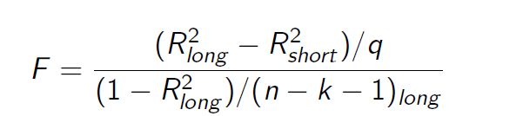


Task (e). Multiple linear regression # 2 (answer)
R long (unrestricted)
R short (restricted)

Slide 70
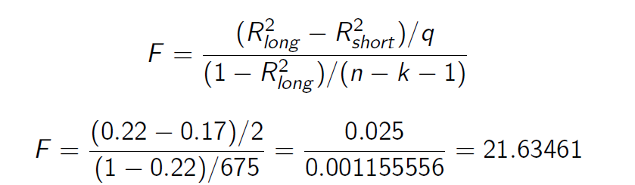
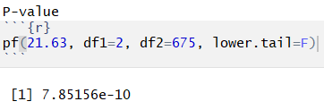
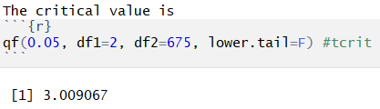
Task (e). Multiple linear regression # 2 (answer)

Slide 71
Task (f). Multiple linear regression # 2
Comment on the overall significance of the regression.

Slide 72
Task (f). Multiple linear regression # 2 (answer)
Comment on the overall significance of the regression.
That is F-test: Coefficients are jointly statistically significant at 0.001 level (p−value :< 2.2e−16, and that is smaller than 0.001)

Slide 73
Task (g). Multiple linear regression # 2
In principle you would expect that successful students attend to classes more.
Task: Check the correlation between the regressors and comment on possible multicollinearity. Calculate the variance inflation factor (VIF) for the coefficients and comment.

Slide 74
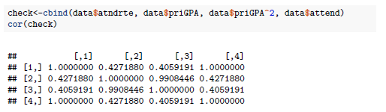
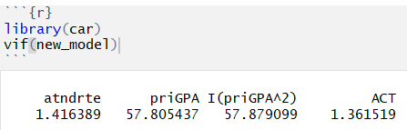
Task (g). Multiple linear regression # 2 (answer)
The correlation between priGPA and priGPA squared is 0.99. Multicollinearity ?
VIF ABOVE 10!

Slide 75
Task (g). Multiple linear regression # 2 (answer)
Not really! In this case since we are not interested in evaluating the effect of changing priGPA without changing priGPA squared.
priGPA and priGPA squared are not linearly dependent (we squared priGPA, which is nonlinear function of priGPA)
Multicollinearity has to be checked and problems have to be solved when you want to estimate the independent effect of two variables which happen to be correlated by chance.
We include priGPA squared in the regression for testing the nonlinear effect of priGPA on standardized score.

Slide 76
Task (g). Multiple linear regression # 2 (answer)
All others correlations are lower than 0.5 which is OK.

Slide 77
Task (h). Multiple linear regression # 2
We could also think that when attending a class a student, whose priGPA and ACT scores are high, would listen and understand the class material better compared to others. In other words, students who attend the class may receive different levels of knowledge and this correlates with the prior college GPA and ACT test score. How would we incorporate this idea to the regression? (i:e: interaction terms atndrte * priGPA and atndrte*ACT)

Slide 78
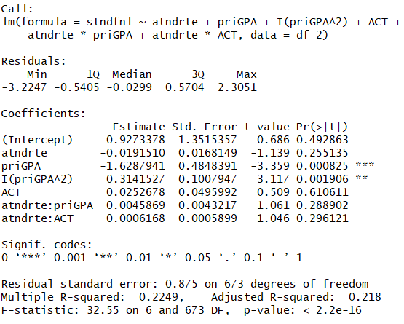
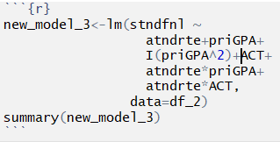
Task (h). Multiple linear regression # 2 (answer)

Slide 79
Task (i). Multiple linear regression # 2
Estimate the regression in part (h). What is the partial effect of atndrte for an average priGPA and ACT level?

Slide 80
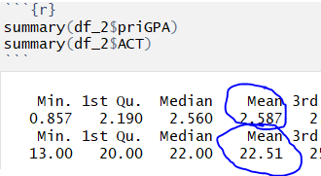
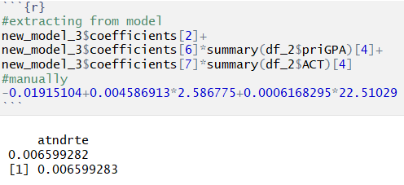
Task (i). Multiple linear regression # 2 (answer)
Estimate the regression in part (h). What is the partial effect of atndrte for an average priGPA and ACT level?

Slide 81
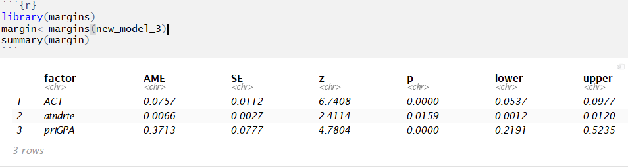
Task (i). Multiple linear regression # 2 (answer)

Slide 82
THANK YOU FOR ATTENTION :)
See you in a week!

